Slide 1
MYP 1 · DESIGN — INDUCTION WEEK
Meet the Design Cycle
From Problem to Solution — how Criteria A to D work together
A
B
C
D

Slide 2
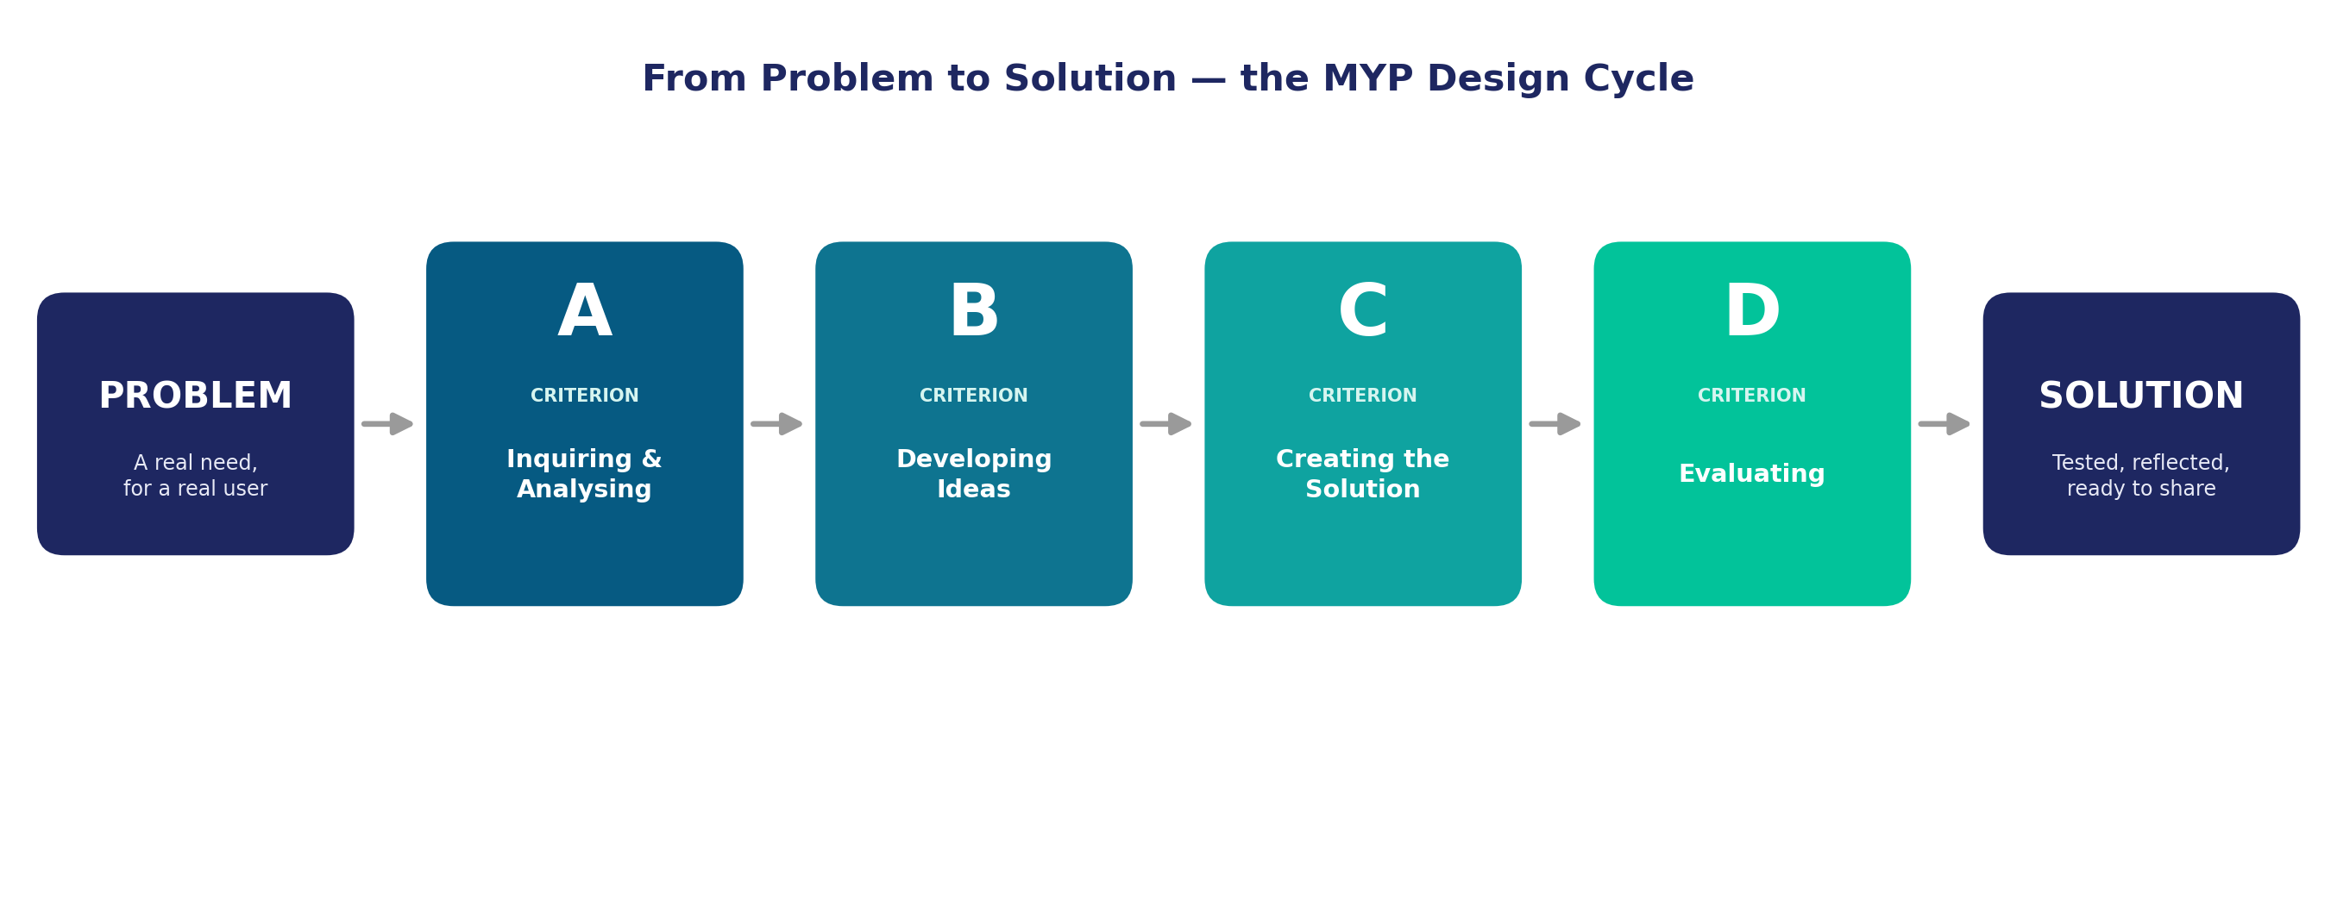
From Problem to Solution
Every Design solution moves through the same four criteria.
We'll watch this happen once on screen — then your group will do it for real.

Slide 3
The Four Criteria, in Plain Language
A
B
C
D
Inquiring & Analysing
Developing Ideas
Creating the Solution
Evaluating
Who needs this, and what do they actually need?
Imagine more than one solution before choosing.
Build it for real, and adapt when something doesn't work.
Test it honestly, and say what you'd change.
Today, only use what you understood from the demonstration — the exact words come later.

